Slide 1
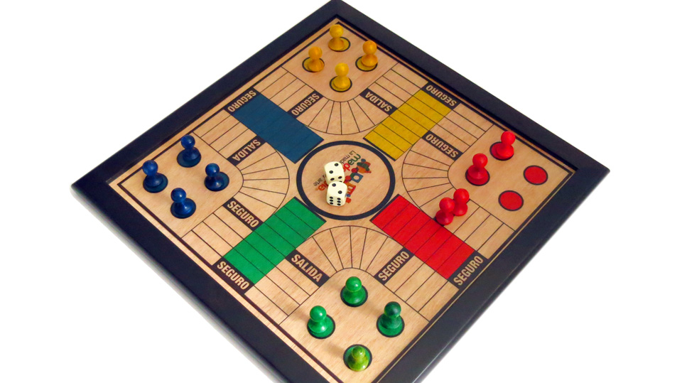
PLAYING WITH TIME
BY FELIPE ANDRADE

Slide 2
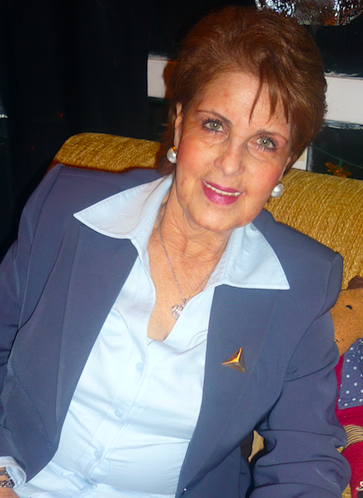
MY GRANDMOTHER
MARIA LUCIA ANDRADE
My Grandma was a loving women, who left a beautiful memory trough her life as a sister, mother, women, friend and more.
Sadly she passed away in 2017, making my whole family reflect on those moments with her and myself reflect on the time i had with her, where that aspect of playing parques oustanted because is the way i spent a some time with her but didnt value it as much as i wouldve like to as i was very young. So i made the parques board as a symbol that represents the idea that i shoudlve value more time with her.
My grandma loved playing parques and she and her friends were quite competitive, she played with me and my sisters whenever she took care of us and those moments are the ones that come to mind when im thinking about her.

Slide 3
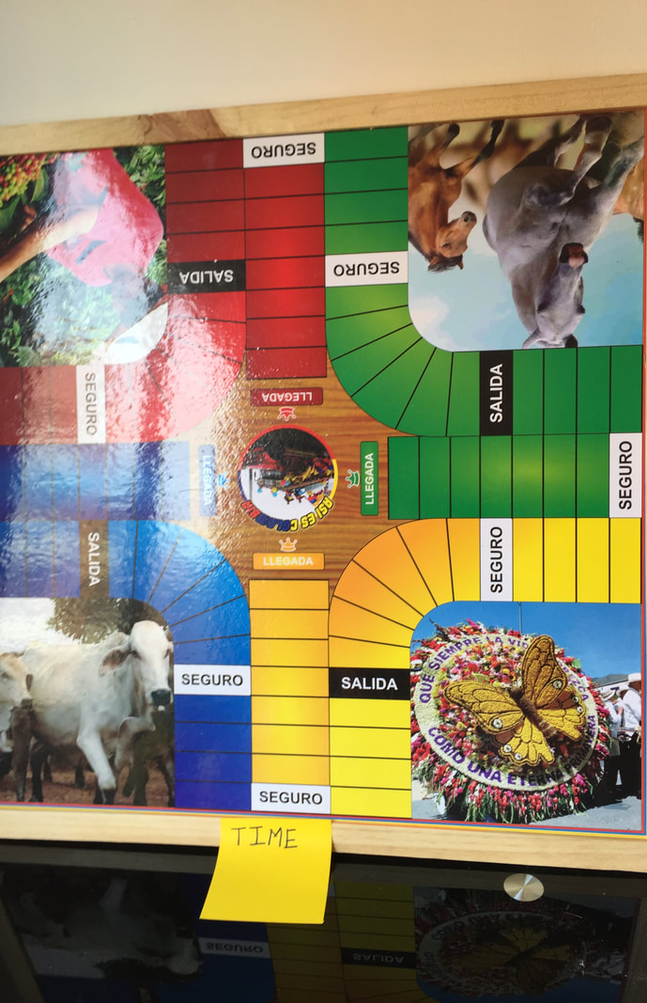
THE REAL ARCHIVE OBJECT
The original parques board is the true archival object
Symbol of time with my grandma
Abstract Concept: Time
Unique Object
Personal Inspiration

Slide 4
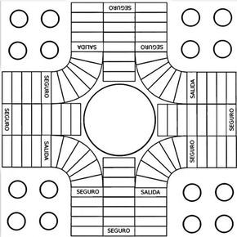
THE ARTCHIVE PICE
Since understanding time was so valuable i placed the parques game as a symbol of enjoying time with my grandama. So im going to create a whole parques board that rebuilds the memory me and my family have of her.
The Parques Board:
Each parques has 4 different colored zones, so for each zone i will use a different memory of my grandmother life. 4 stages in total for which i will use the same color but in a diferent tone. 1. Memory as a sister 2. Memory as a mother 3. Memory as a grandmother 4. Memory as a women.
Each parques zone has 3 safe squares, instead of those safe zones saying EXIT or SAFE they will be different words that represent the memory they are in. For example if the zone they are in is memory of a grandma the words could be such as: loving, carrying,2nd mother.
Each zone also has its respective image so an image of the specific memory of my grandma life will be included. The image of the center will resemble the whole memory we have ( my family)of her to show how every memories we have brings us to the final image.
Parques is played with two dices, for this one dice will highlight the number that forms the day she was born and the other dice the day she passed away.

Slide 5
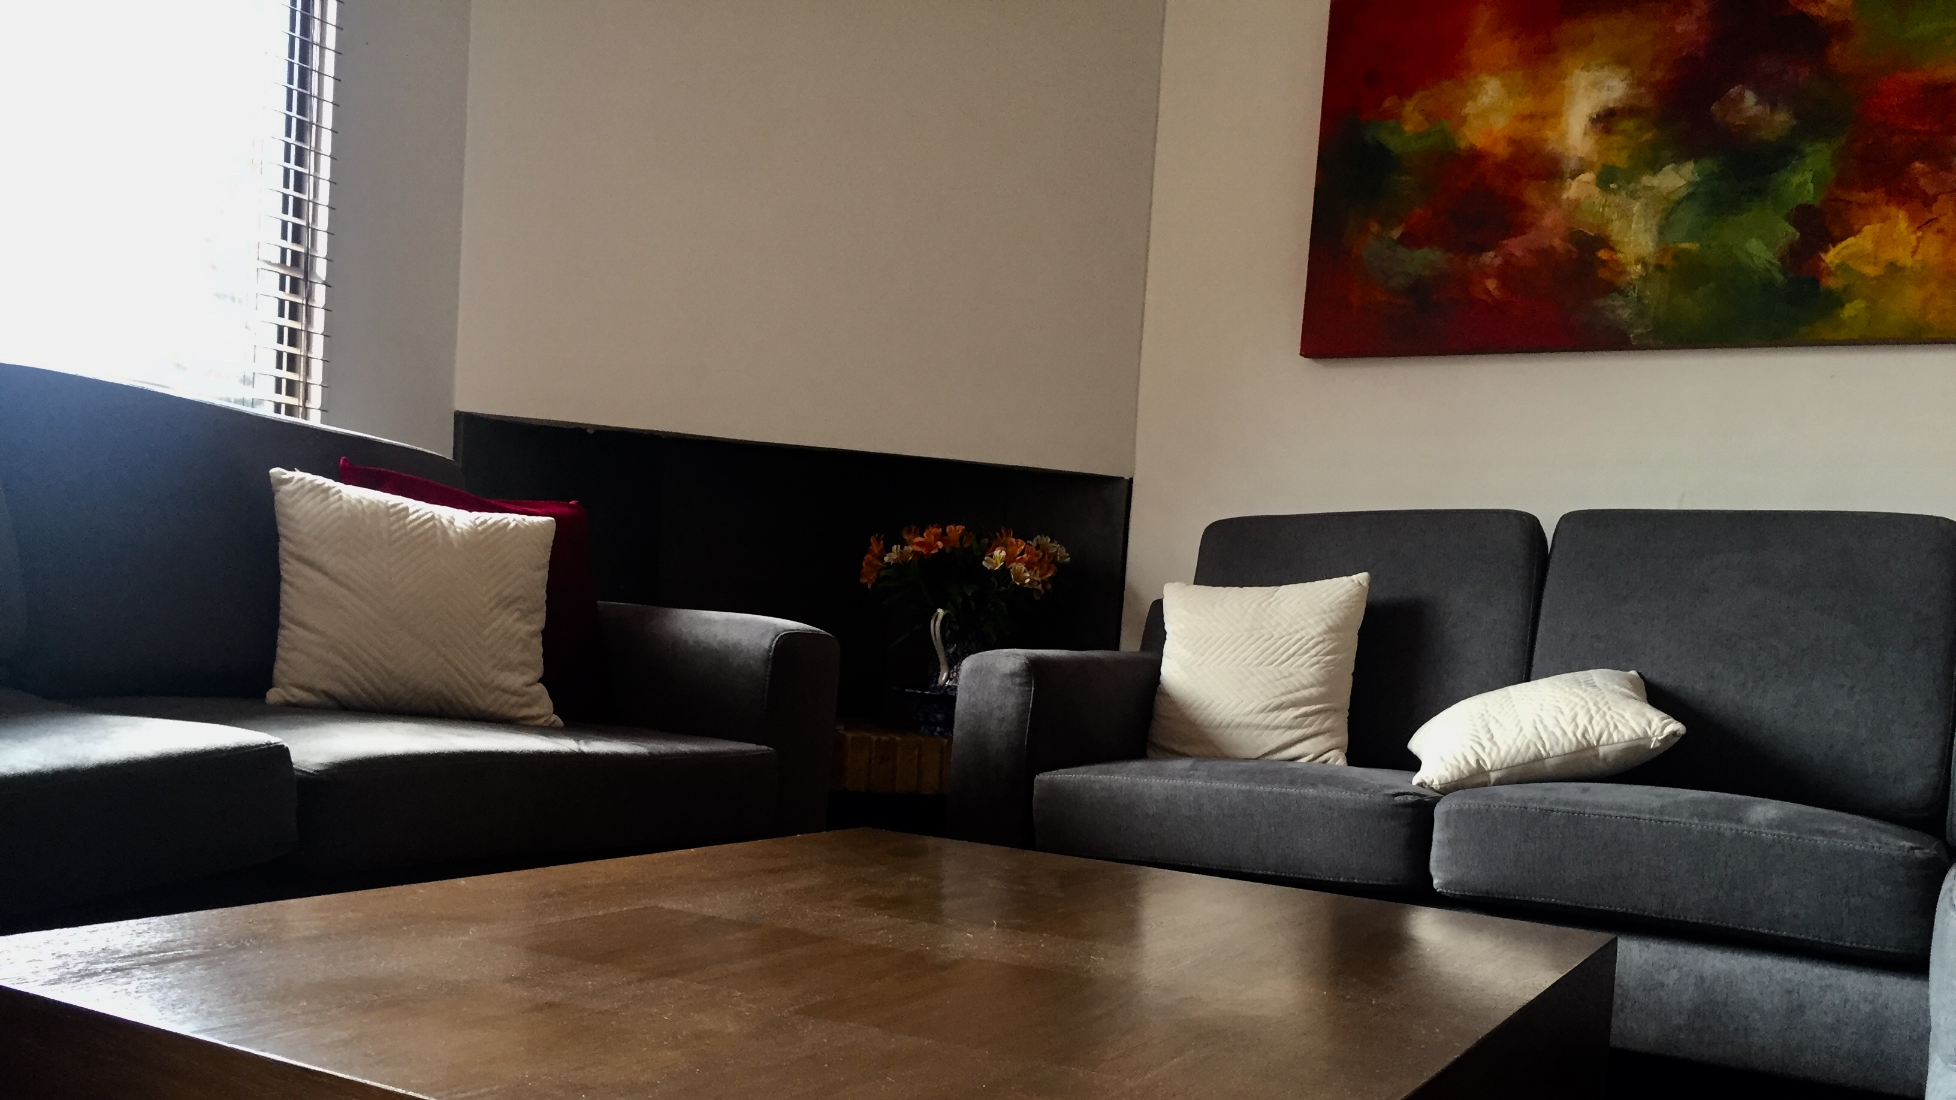
THE ARCHIVE PICE IN BODY AND SPACE
The place of exposition for my art piece is key, thats why i decided to located in the living room of my house in the center table were we usually would play parques and the place my grandma was once in.
Relation to space
Body is based on the participation of my family members in a happening.
Recorded instead of witnessed
Happening based on me inviting my family to play parques but instead of bringin the original parques board i will bring the artchive piece and the whole escense of that happening is the physical and emotional reaction of my family to the parques board and all the symbols it contains. Finishing the idea of the happening we will play a whole game of parques in that board.

Slide 6
THE SKETCH
Its important to take into account the dices, and the playing parts, plus the wood border. Also as said I will build it.

Slide 7
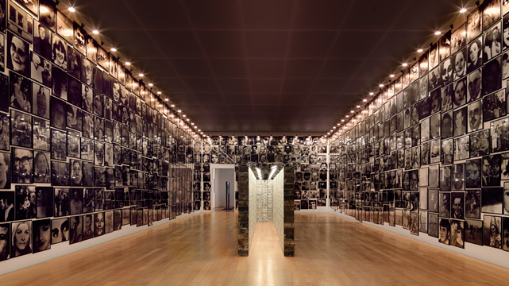
REFERENCES
Christian Boltanski
Instalation of DOPO
An instalation of narrative addressing individual and collective memory, relating the past with the present, and the history with each individuals life.
The subject of the archive art piece are history and life duration. Making emphasis and reflecting upon abscence (of an individual)
He brings memories back to the surface though the eyes and faces of strangers emerging from photographies who are in suspended in lines and go around without stopping to a point where even if you follow the photography youll have to let it go at some moment, jsut like memories.
Chirstian bolstanski though his work does tribute to Mario Merz work and the ability to be present in ones own time, nurturing it and making it fruitful for those who will come next.
He shows how memories are right there and come like brain circuit when reactivated by opening memory drawers.

Slide 8
THE REFERENCES INBEDED IN MY PIECE
The archival reference is based on me wanting to express and use this art instalation as an example of what i want my art piece to mean.
The way the parques board relates the past memory of her and the memery we have nowadays of her, and how those memories are different for each individual as each had a different history with my grandma.
I also include his subjects of life duration (making emphasis on the relevance of time) and abscence, taking into account how by seeing the parques and the symbols it has my family and i will give a relfection on the relevance of time with my grandma, trough those brain circiuts memories that Chsitian also causes with his photographies.
Lastly to do the same reflection the DOPO instalation is about: the ability to be present on ones life, because it relates to the idea that i want to cause of understnading that to value time with family is an ability we all need.

Slide 9
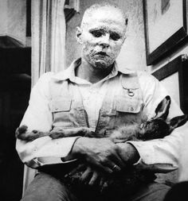
BODY AND SPACE REFERENCE
As said before the happening is a more serious approach to this type of art, so i choose a more serious artist who approaches in the similar motive i want to:
Joseph Beuys
Every human being is an artist
He did a happening doing lectures and dramatic actions doing what he called social sculpture.
Using art to try and change consciounsness, believing art can and should trnasform people everydays life.
Impulses of relfection though his happenings.

Slide 10
THE REFERENCE INBEEDED IN THE SPACE AND THE BODY
The seriousness of the happening, as it isnt a playful and acted one.
I want to cause the same reflection trough my happenin as Joseph did because i want for every faily member to reflect of the time with my grandma and be conscious of the menaing of time with the love ones who are still here.
Like he did use art to transform a peoples life, i want to transform my family trough my art piece by making them more conscious of the value of time.
Impulses of reflection, i want my family when seeing the different symbols in the parques to have those impulses of reflection of their relation and history with my grandma.

